Slide 1
Virtual Memory

Slide 2
Background
Code needs to be in memory to execute, but entire program rarely used
  Error code, unusual routines, large data structures
Entire program code not needed at same time
Consider ability to execute partially-loaded program
  Program no longer constrained by limits of physical memory
  Each program takes less memory while running -> more programs run at the same time
  Less I/O needed to load or swap programs into memory -> each user program runs faster

Slide 3
Background (Cont.)
Virtual memory – separation of user logical memory from physical memory
  Only part of the program needs to be in memory for execution
  Logical address space can therefore be much larger than physical address space
  Allows address spaces to be shared by several processes
  Allows for more efficient process creation
  More programs running concurrently
  Less I/O needed to load or swap processes

Slide 4
Virtual Memory
is a storage mechanism which offers user an illusion of having a very big main memory. It is done by treating a part of secondary memory as the main memory. In Virtual memory, the user can store processes with a bigger size than the available main memory.
Therefore, instead of loading one long process in the main memory, the OS loads the various parts of more than one process in the main memory. Virtual memory is mostly implemented with demand paging and demand segmentation.

Slide 5
Demand paging
is identical to the paging system with swapping.
In demand paging, a page is delivered into the memory on demand i.e., only when a reference is made to a location on that page.
Demand paging combines the feature of simple paging and implement virtual memory as it has a large virtual memory.
Lazy swapper concept is implemented in demand paging in which a page is not swapped into the memory unless it is required.

Slide 6

Demand Paging
Could bring entire process into memory at load time
Or bring a page into memory only when it is needed
  Less I/O needed, no unnecessary I/O
  Less memory needed
  Faster response
  More users
Similar to paging system with swapping (diagram on right)
Page is needed ⇒ reference to it
  invalid reference ⇒ abort
  not-in-memory ⇒ bring to memory
Lazy swapper – never swaps a page into memory unless page will be needed

Slide 7
Page Fault
A page fault occurs when a program attempts to access data or code that is in its address space, but is not currently located in the system RAM.

Slide 8

Valid-Invalid Bit
With each page table entry a valid–invalid bit is associated
(v ⇒ in-memory – memory resident, i ⇒ not-in-memory)
Initially valid–invalid bit is set to i on all entries
Example of a page table snapshot:
During MMU address translation, if valid–invalid bit in page table entry is i ⇒ page fault

Slide 9

Page Table When Some Pages Are Not in Main Memory

Slide 10
Page Fault
If there is a reference to a page, first reference to that page will trap to operating system:
page fault
Operating system looks at another table to decide:
  Invalid reference ⇒ abort
  Just not in memory
Find free frame
Swap page into frame via scheduled disk operation
Reset tables to indicate page now in memory
Set validation bit = v
Restart the instruction that caused the page fault

Slide 11

Steps in Handling a Page Fault

Slide 12
Pure Demand Paging
There are cases when no pages are loaded into the memory initially, pages are only loaded when demanded by the process by generating page faults. This is called Pure Demand Paging.
In pure demand paging, even a single page is not loaded into memory initially. Hence pure demand paging causes a page fault
When starting execution of a process with no pages in memory, the operating system sets the instruction pointer to the first instruction of the process, which is on a non-memory resident page, the process immediately faults for the page. After this page is brought into memory, the process continues to execute, faulting as necessary until every page that it needs is in memory. At that point, it can execute with no more faults. This schema is pure demand paging.

Slide 13
Aspects of Demand Paging
Extreme case – start process with no pages in memory
  OS sets instruction pointer to first instruction of process, non-memory-resident -> page fault
  And for every other process pages on first access
  Pure demand paging
Actually, a given instruction could access multiple pages -> multiple page faults
Hardware support needed for demand paging
  Page table with valid / invalid bit
  Secondary memory (swap device with swap space)
  Instruction restart

Slide 14
Performance of Demand Paging (Cont.)
Page Fault Rate 0 ≤ p ≤ 1
  if p = 0 no page faults
  if p = 1, every reference is a fault
Effective Access Time (EAT)
EAT = (1 – p) x memory access
+ p (page fault overhead
+ swap page out
+ swap page in )

Slide 15
Demand Paging Example
Memory access time = 200 nanoseconds
Average page-fault service time = 8 milliseconds
EAT = (1 – p) x 200 + p (8 milliseconds)
= (1 – p x 200 + p x 8,000,000
= 200 + p x 7,999,800

Slide 16
What Happens if There is no Free Frame?
Used up by process pages
Also in demand from the kernel, I/O buffers, etc
How much to allocate to each?
Page replacement – find some page in memory, but not really in use, page it out
  Algorithm – terminate? swap out? replace the page?
  Performance – want an algorithm which will result in minimum number of page faults
Same page may be brought into memory several times

Slide 17
Page Replacement
In an operating system that uses paging for memory management, a page replacement algorithm is needed to decide which page needs to be replaced when new page comes in.
Page Fault – A page fault happens when a running program accesses a memory page that is mapped into the virtual address space, but not loaded in physical memory.
Since actual physical memory is much smaller than virtual memory, page faults happen. In case of page fault, Operating System might have to replace one of the existing pages with the newly needed page. Different page replacement algorithms suggest different ways to decide which page to replace. The target for all algorithms is to reduce the number of page faults.

Slide 18
Page Replacement
Prevent over-allocation of memory by modifying page-fault service routine to include page replacement
Use modify (dirty) bit to reduce overhead of page transfers – only modified pages are written to disk
Page replacement completes separation between logical memory and physical memory – large virtual memory can be provided on a smaller physical memory

Slide 19

Need For Page Replacement

Slide 20
Basic Page Replacement
Find the location of the desired page on disk
Find a free frame:
- If there is a free frame, use it
- If there is no free frame, use a page replacement algorithm to select a victim frame
- Write victim frame to disk if dirty
Bring the desired page into the (newly) free frame; update the page and frame tables
Continue the process by restarting the instruction that caused the trap

Slide 21

Page Replacement

Slide 22
Page and Frame Replacement Algorithms
Frame-allocation algorithm determines
  How many frames to give each process
Page-replacement algorithm
  Want lowest page-fault rate on both first access and re-access
Evaluate algorithm by running it on a particular string of memory references (reference string) and computing the number of page faults on that string
  String is just page numbers, not full addresses
  Repeated access to the same page does not cause a page fault
  Results depend on number of frames available
In all our examples, the reference string of referenced page numbers is
7,0,1,2,0,3,0,4,2,3,0,3,0,3,2,1,2,0,1,7,0,1

Slide 23

Graph of Page Faults Versus The Number of Frames

Slide 24
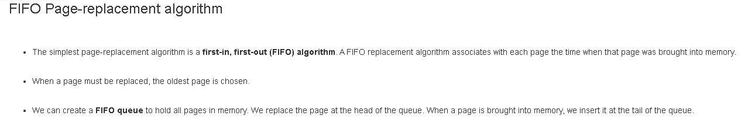

Slide 25

First-In-First-Out (FIFO) Algorithm
Reference string: 7,0,1,2,0,3,0,4,2,3,0,3,0,3,2,1,2,0,1,7,0,1
3 frames (3 pages can be in memory at a time per process)
Can vary by reference string: consider 1,2,3,4,1,2,5,1,2,3,4,5
  Adding more frames can cause more page faults!
    Belady’s Anomaly
15 page faults

Slide 26
Bélády’s anomaly is the name given to the phenomenon where increasing the number of page frames results in an increase in the number of page faults for a given memory access pattern.

Slide 27
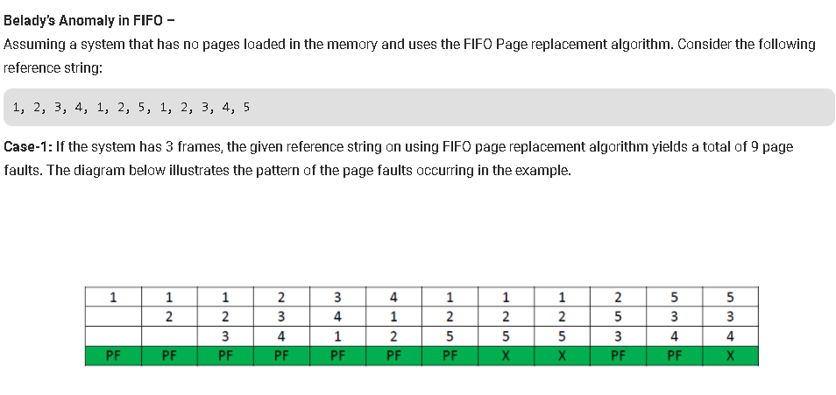

Slide 28
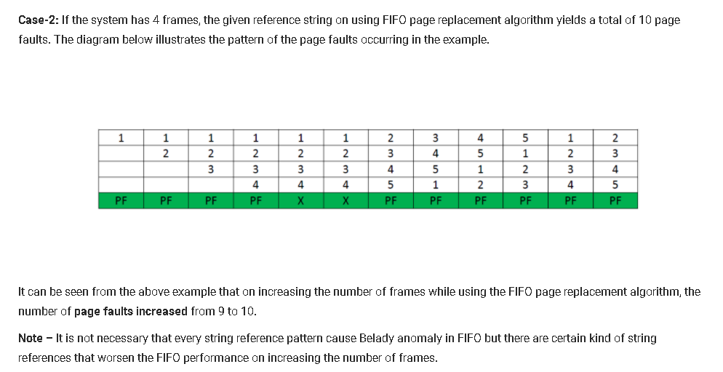

Slide 29

FIFO Illustrating Belady’s Anomaly

Slide 30

Optimal Algorithm
Replace page that will not be used for longest period of time
  9 is optimal for the example
Used for measuring how well your algorithm performs

Slide 31

Least Recently Used (LRU) Algorithm
Use past knowledge rather than future
Replace page that has not been used in the most amount of time
Associate time of last use with each page
12 faults – better than FIFO but worse than OPT
Generally good algorithm and frequently used

Slide 32
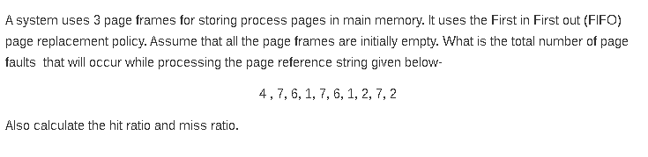

Slide 33
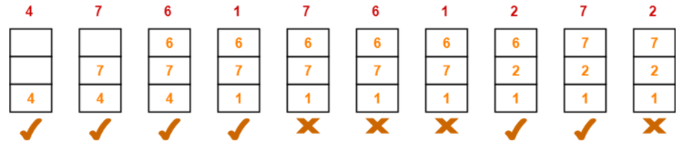
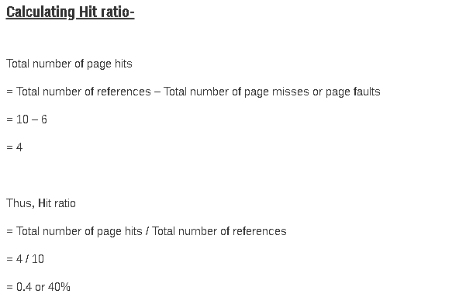

Slide 34
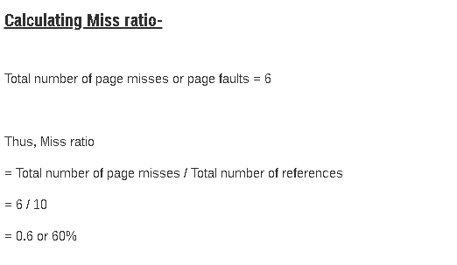

Slide 35
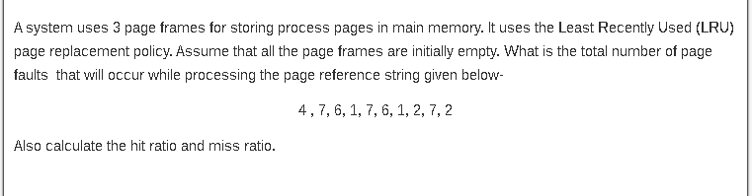

Slide 36
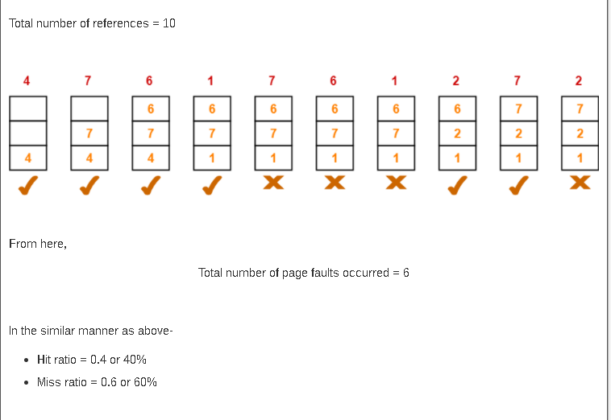

Slide 37
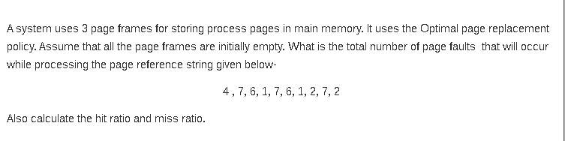

Slide 38
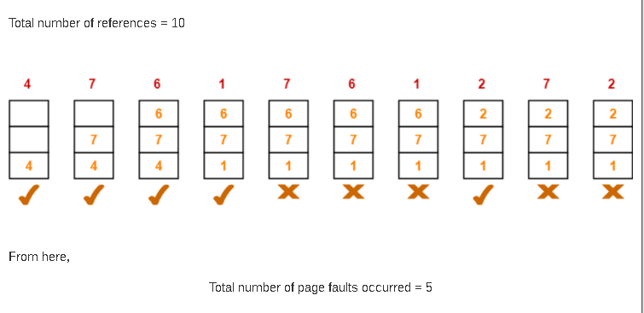


Slide 39
LRU Algorithm (Cont.)
Counter implementation
  Every page entry has a counter; every time page is referenced through this entry, copy the clock into the counter
  When a page needs to be changed, look at the counters to find smallest value
    Search through table needed
Stack implementation
  Keep a stack of page numbers in a double link form:
LRU and OPT are cases of stack algorithms that don’t have Belady’s Anomaly

Slide 40
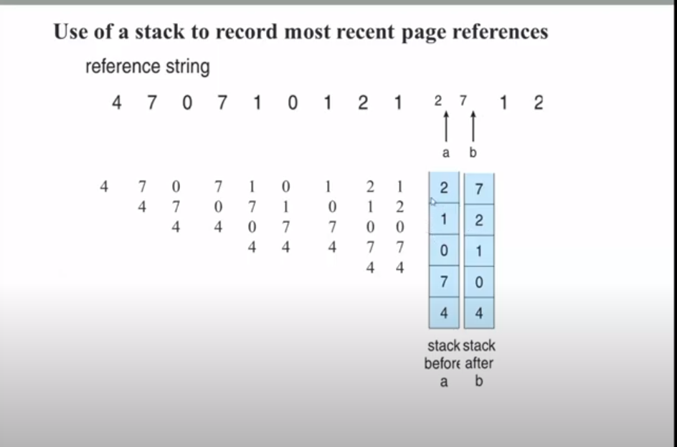

Slide 41

Use Of A Stack to Record Most Recent Page References

Slide 42
LRU Approximation Algorithms
LRU needs special hardware and still slow
Reference bit
  With each page associate a bit, initially = 0
  When page is referenced bit set to 1
  Replace any with reference bit = 0 (if one exists)
    We do not know the order, however
Second-chance algorithm
  Generally FIFO, plus hardware-provided reference bit
  Clock replacement
  If page to be replaced has
    Reference bit = 0 -> replace it
    reference bit = 1 then:
      set reference bit 0, leave page in memory
      replace next page, subject to same rules

Slide 43

Second-Chance (clock) Page-Replacement Algorithm

Slide 44
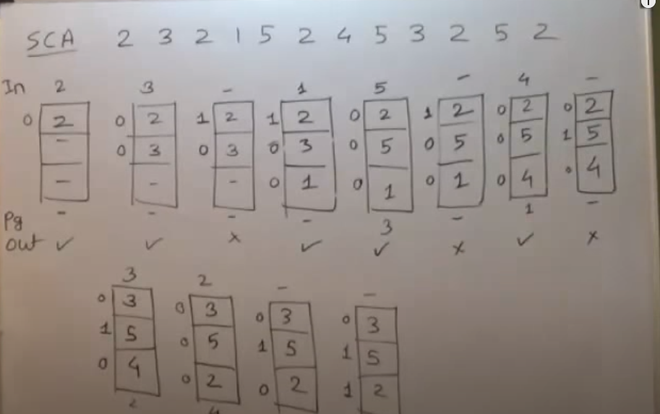

Slide 45
Enhanced Second-Chance Algorithm
Improve algorithm by using reference bit and modify bit (if available) in concert
Take ordered pair (reference, modify)
(0, 0) neither recently used not modified – best page to replace
(0, 1) not recently used but modified – not quite as good, must write out before replacement
(1, 0) recently used but clean – probably will be used again soon
(1, 1) recently used and modified – probably will be used again soon and need to write out before replacement
When page replacement called for, use the clock scheme but use the four classes replace page in lowest non-empty class
  Might need to search circular queue several times

Slide 46
Counting Algorithms
Keep a counter of the number of references that have been made to each page
  Not common
Lease Frequently Used (LFU) Algorithm: replaces page with smallest count
Most Frequently Used (MFU) Algorithm: based on the argument that the page with the smallest count was probably just brought in and has yet to be used

Slide 47
Page-Buffering Algorithms
Keep a pool of free frames, always
  Then frame available when needed, not found at fault time
  Read page into free frame and select victim to evict and add to free pool
  When convenient, evict victim
Possibly, keep list of modified pages
  When backing store otherwise idle, write pages there and set to non-dirty
Possibly, keep free frame contents intact and note what is in them
  If referenced again before reused, no need to load contents again from disk
  Generally useful to reduce penalty if wrong victim frame selected

Slide 48
Applications and Page Replacement
All of these algorithms have OS guessing about future page access
Some applications have better knowledge – i.e. databases
Memory intensive applications can cause double buffering
  OS keeps copy of page in memory as I/O buffer
  Application keeps page in memory for its own work
Operating system can given direct access to the disk, getting out of the way of the applications
  Raw disk mode
Bypasses buffering, locking, etc

Slide 49
LRU Algorithm (Cont.)
Counter implementation
  Every page entry has a counter; every time page is referenced through this entry, copy the clock into the counter
  When a page needs to be changed, look at the counters to find smallest value
    Search through table needed
Stack implementation
  Keep a stack of page numbers in a double link form:
LRU and OPT are cases of stack algorithms that don’t have Belady’s Anomaly

Slide 50
Use Of A Stack to Record Most Recent Page References

Slide 52
LRU Approximation Algorithms
LRU needs special hardware and still slow
Reference bit
  With each page associate a bit, initially = 0
  When page is referenced bit set to 1
  Replace any with reference bit = 0 (if one exists)
    We do not know the order, however
Second-chance algorithm
  Generally FIFO, plus hardware-provided reference bit
  Clock replacement
  If page to be replaced has
    Reference bit = 0 -> replace it
    reference bit = 1 then:
      set reference bit 0, leave page in memory
      replace next page, subject to same rules

Slide 53
Second-Chance (clock) Page-Replacement Algorithm

Slide 55
Enhanced Second-Chance Algorithm
Improve algorithm by using reference bit and modify bit (if available) in concert
Take ordered pair (reference, modify)
(0, 0) neither recently used not modified – best page to replace
(0, 1) not recently used but modified – not quite as good, must write out before replacement
(1, 0) recently used but clean – probably will be used again soon
(1, 1) recently used and modified – probably will be used again soon and need to write out before replacement
When page replacement called for, use the clock scheme but use the four classes replace page in lowest non-empty class
  Might need to search circular queue several times

Slide 56
Counting Algorithms
Keep a counter of the number of references that have been made to each page
  Not common
Lease Frequently Used (LFU) Algorithm: replaces page with smallest count
Most Frequently Used (MFU) Algorithm: based on the argument that the page with the smallest count was probably just brought in and has yet to be used

Slide 57
Page-Buffering Algorithms
Keep a pool of free frames, always
  Then frame available when needed, not found at fault time
  Read page into free frame and select victim to evict and add to free pool
  When convenient, evict victim
Possibly, keep list of modified pages
  When backing store otherwise idle, write pages there and set to non-dirty
Possibly, keep free frame contents intact and note what is in them
  If referenced again before reused, no need to load contents again from disk
  Generally useful to reduce penalty if wrong victim frame selected

Slide 58
Applications and Page Replacement
All of these algorithms have OS guessing about future page access
Some applications have better knowledge – i.e. databases
Memory intensive applications can cause double buffering
  OS keeps copy of page in memory as I/O buffer
  Application keeps page in memory for its own work
Operating system can given direct access to the disk, getting out of the way of the applications
  Raw disk mode
Bypasses buffering, locking, etc

Slide 59
Allocation of Frames
Each process needs minimum number of frames
Two major allocation schemes
  fixed allocation
  priority allocation

Slide 60


Fixed Allocation
Equal allocation – For example, if there are 100 frames (after allocating frames for the OS) and 5 processes, give each process 20 frames
  Keep some as free frame buffer pool
Proportional allocation – Allocate according to the size of process
  Dynamic as degree of multiprogramming, process sizes change

Slide 61
Priority Allocation
Use a proportional allocation scheme using priorities rather than size
If process P_{i} generates a page fault,
  select for replacement one of its frames
  select for replacement a frame from a process with lower priority number

Slide 62
Global vs. Local Allocation
Global replacement – process selects a replacement frame from the set of all frames; one process can take a frame from another
  But then process execution time can vary greatly
  But greater throughput so more common
Local replacement – each process selects from only its own set of allocated frames
  More consistent per-process performance
  But possibly underutilized memory

Slide 63
Thrashing
If a process does not have “enough” pages, the page-fault rate is very high
  Page fault to get page
  Replace existing frame
  But quickly need replaced frame back
  This leads to:
    Low CPU utilization
    Operating system thinking that it needs to increase the degree of multiprogramming
    Another process added to the system
Thrashing ≡ a process is busy swapping pages in and out

Slide 64

Thrashing (Cont.)

Slide 65
Demand Paging and Thrashing
Why does demand paging work?
Locality model
  Process migrates from one locality to another
  Localities may overlap
Why does thrashing occur?
Σ size of locality > total memory size
  Limit effects by using local or priority page replacement

Slide 66
Locality Of References
This important fundamental observation comes from properties of programs. The most important program property that we regularly exploit is locality of references : Programs tend to reuse data and instructions they have used recently
90/10 rule comes from empirical observation:
"A program spends 90% of its time in 10% of its code“
An implication of locality is that we can predict with reasonable accuracy what instructions and data a program will use in the near future based on its accesses in the recent past.
Two different types of locality have been observed:
Temporal locality: states that recently accessed items are likely to be accessed in the near future.
Spatial locality: says that items whose addresses are near one another tend to be referenced close together in time.

Slide 67
Locality model
The locality model notes that processes typically access memory references in a given locality, making lots of references to the same general area of memory before moving periodically to a new locality
If we could just keep as many frames as are involved in the current locality, then page faulting would occur primarily on switches from one locality to another.

Slide 68

Locality In A Memory-Reference Pattern

Slide 69

Working-Set Model
Δ ≡ working-set window ≡ a fixed number of page references
Example: 10,000 instructions
WSS_{i} (working set of Process P_{i}) =
total number of pages referenced in the most recent Δ (varies in time)
  if Δ too small will not encompass entire locality
  if Δ too large will encompass several localities
  if Δ = ∞ ⇒ will encompass entire program
D = Σ WSS_{i} ≡ total demand frames
  Approximation of locality
if D > m ⇒ Thrashing
Policy if D > m, then suspend or swap out one of the processes

Slide 70
Keeping Track of the Working Set
Approximate with interval timer + a reference bit
Example: Δ = 10,000
  Timer interrupts after every 5000 time units
  Keep in memory 2 bits for each page
  Whenever a timer interrupts copy and sets the values of all reference bits to 0
  If one of the bits in memory = 1 ⇒ page in working set
Why is this not completely accurate?
Improvement = 10 bits and interrupt every 1000 time units

Slide 71

Page-Fault Frequency
More direct approach than WSS
Establish “acceptable” page-fault frequency (PFF) rate and use local replacement policy
  If actual rate too low, process loses frame
  If actual rate too high, process gains frame

Slide 72

Working Sets and Page Fault Rates
Direct relationship between working set of a process and its page-fault rate
Working set changes over time
Peaks and valleys over time

